Slide 1
ERC20 Experiments

Slide 2
About Data
Top 300 ERC20 Tokens from Etherscan
276 contracts verified on etherscan with no bugs
24 contracts with bugs on etherscan
10 Types of implementations identified
49 contracts failed to meet the specifications
38 contracts failed with Fake Deposit Attack
11 contracts failed by missing either approve or transfer event
4 contracts with bugs fail specification properties

Slide 3
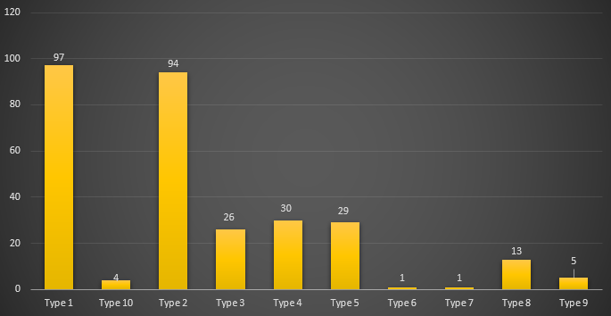
Types of Implementation
Contracts with Bytcode – 4
Contracts with Proxy impl – 29
Contracts with SafeMath – 217
Fake Deposit Attack – 39

Slide 4
Types of Implementation – Failed Contracts
SafeMath – Type 2, Type 7
Fake Deposit Attack – Type 3, Type 8
No SafeMath – Type 9

Slide 5
Types of Implementation – Failed Contracts
Type 1 – 0 contracts failed verification
Type 2 – 1 contract failed the pattern
Type 1 & Type 2 use SafeMath

